Slide 1
Artefacts
https://docs.google.com/document/d/1Qqc1jaZ3kVgYFFwHNZ0iWlH59VxQOEePim3AP7InSjM/edit

Slide 2
System use case for Smart City project 1.1 (Users)
Title: System use case for Smart City 1.1 project (Users)
Account Opening
Account Closing
View Information
Search Result
Request user access

Slide 3
System use case for Smart City project 1.1 (Admin)
Title: System use case for Smart City 1.1 project (Admin)
Account Opening
Account Closing
Upload/Edit/Delete Information

Slide 4
Component diagram for Smart City 1.1 - Hark
<<Component>>
Home Page/ Welcome Page
<<Component>>
Login Page
<<Component>>
User City Information Page
<<Component>> Request information page
Search for user information in database
Authentication User database
User database
<<Component>> Create account page
<<Component>>
View other user information page
<<Component>> Account close page

Slide 5
Data Flow diagram for Smart City 1.1
WELCOME PAGE
LOG IN
MAIN PAGE
LOG OUT
USER
REQUEST ACCESS TO OTHER USER TYPES
CITY INFORMATION
SEARCH
ACCOUNT CREATION
RESULTS PAGE
ACCOUNT PAGE
FORGOT DETAILS
RETRIEVE DETAILS

Slide 6
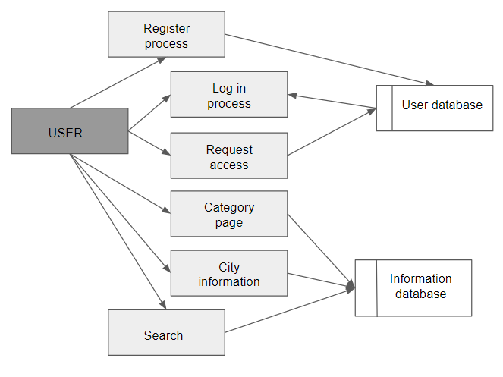
Data flow diagram for Smart City 1.2

Slide 7
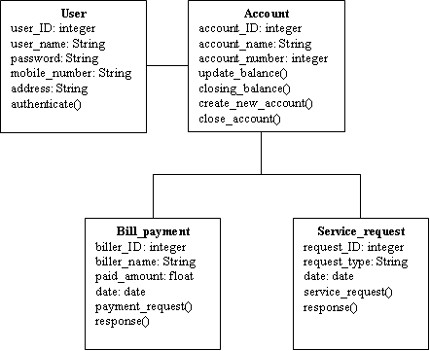
Class Diagram for Smart City 1.1 - Raj

Slide 8
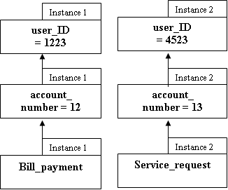
Object diagram for Smart City 1.1 - Oliver

Slide 9
Sequence Diagram for Smart City 1.1 - Hark - Login
User
Homepage/Login
Validate User
Database
Logging in
Validate User
User access
User views City information
City Information
City Information

Slide 10
Sequence Diagram for Smart City 1.2 - Register - Karen
User
Register
Database
Enter User Details
Validate Details
Insert User Details
Send User Details
Return Result

Slide 11
Sequence Diagram for Smart City 1.2 - Search
User
Search
Database
Enter query
Validate query
Select search type
Search for results
Send query
Return Result

Slide 12
Statechart Diagram for Smart City 1.1 - Log in
Start
Idle
Log in
Input login details
Check login details against database
If unsuccessful
Error
(pop up)
Intermediate
states
Initialize
state
Notify if log in was successful or not
Cancel
Login
If successful
Show main page
Final
State
End

Slide 13
Statechart Diagram for Smart City 1.1 - Search (Users)
Start
Idle
Search
Put in search term
Search term in database
Intermediate
states
Initialize
state
Retrieve relevant information
Cancel
Search
Display search result
Final
State
End

Slide 14
Statechart Diagram for Smart City 1.1 - Upload/Edit/Delete Information (Admin)
Start
Idle
Edit/Upload/Delete
Input changes
Confirm changes
If unsuccessful
Error
(pop up)
Intermediate
states
Initialize
state
Notify if changes are successful or not
Cancel
Edit/Upload/Delete
If successful
Return to initial page
Final
State
End

Slide 15
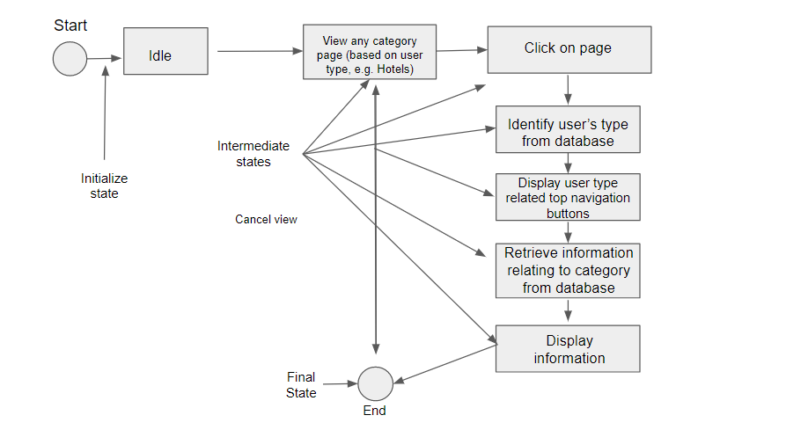
State chart diagram for Smart City 1.2 - User Information Pages

Slide 16
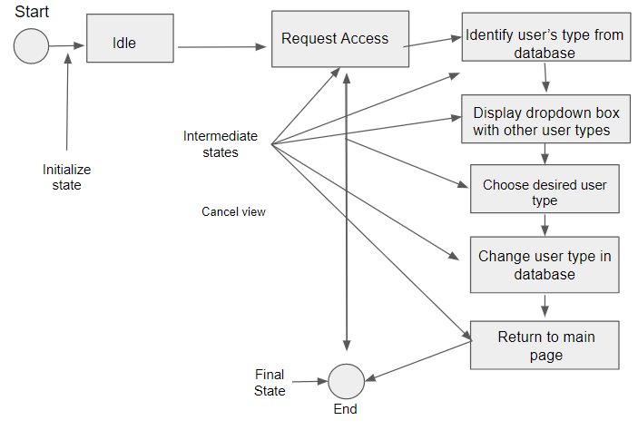
State chart diagram for Smart City 1.2 – Request Access

Slide 17
Entity relationship diagram- 1.1
Name
D.O.B
Mobile number
Address
Specific Info
Request other user type
User
Has
User type
Username
Password
Login /Logout
Performs
Actions
Search categories
View account
View city information
View user related information

Slide 18
Entity relationship diagram- Smart City Project 1.1 & 1.2
phone_number
date_joined
date_joined
username
password
D.O.B
is_active
first_name
is_superuser
email
Account
last_login
address
Student
last_name
User
user_type
Businessman
Views
Has
Logout
Tourist
Profile
Requests
citymap
search_type
cityinformation
search
query
parks
libraries
object_type
zoos
colleges
industry
museums
restaurants
hotels
malls

